Slide 1

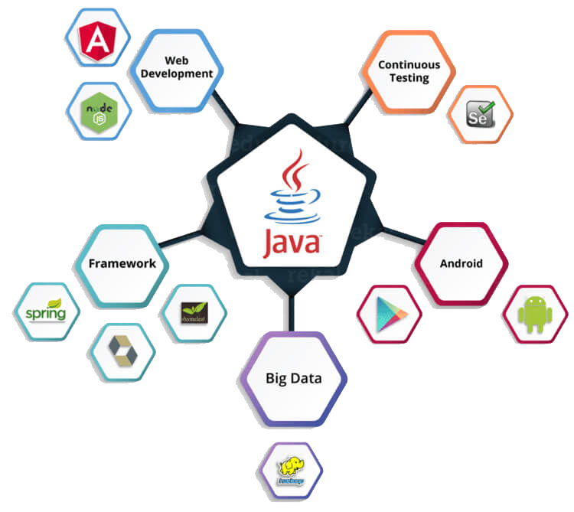
Presenter :
- Duy Nguyen
- Thanh Bui
- Quy Nguyen
- Nghia Pham
Mentor : Tan Le
<number>

Slide 2
CONTENT
Java core
Design Patterns
OOD principle
Hibernate
Spring
JavaScript
Angular
<number>

Slide 3
JAVA CORE
What is Java ?
01
Variable, Methods
02
Class, Object
03
Exception
<number>
04
<number>

Slide 4
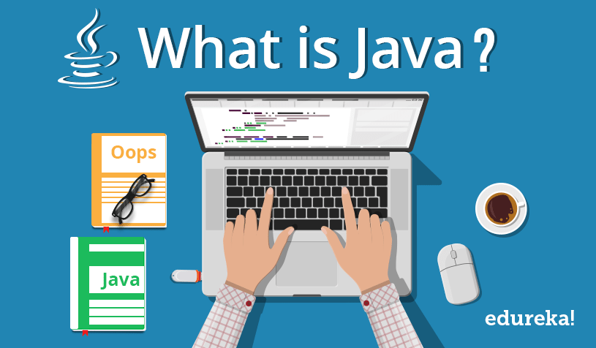
JAVA CORE
<number>

Slide 5
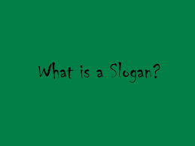
JAVA CORE
<number>

Slide 6
JAVA CORE
Write once, run anywhere
Providing no-cost run times on popular platforms.
<number>

Slide 7
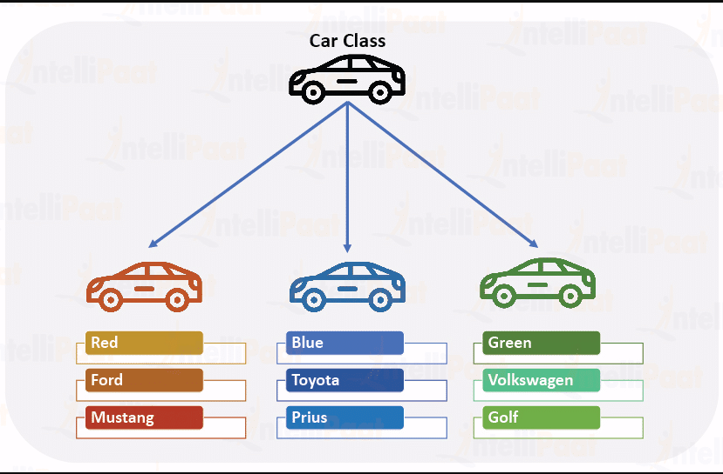
JAVA CORE
<number>

Slide 8
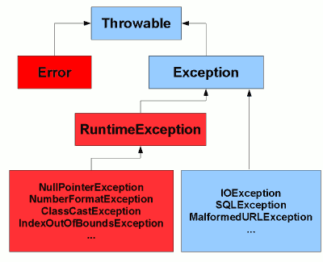
JAVA CORE
<number>

Slide 9
JAVA CORE
Object
O
Oriented
O
Programming
P
<number>

Slide 10

JAVA CORE
01
Encapsulation
02
Inheritance
INHERITANCE
03
Polymorphism
04
Abstraction
<number>

Slide 11
JAVA CORE
Class
Variables
Methods
ENCAPSULATION
<number>

Slide 12
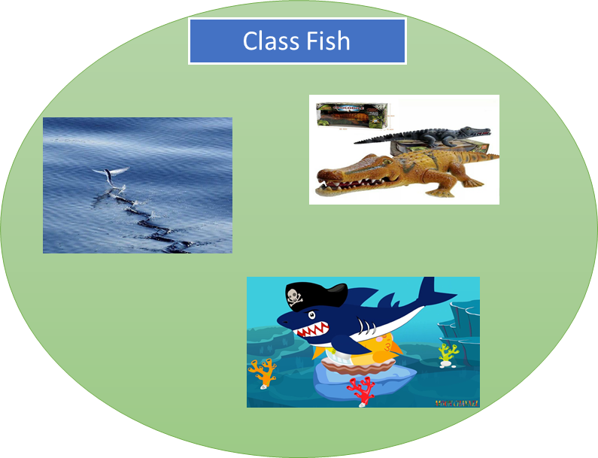
JAVA CORE
INHERITANCE & POLYMORPHISM
<number>

Slide 13
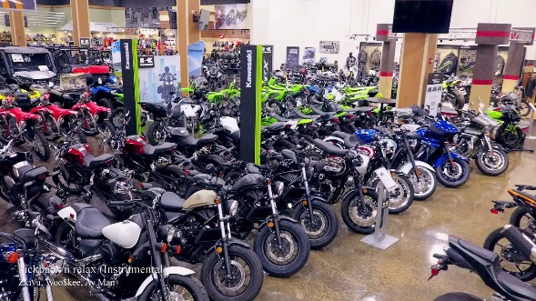
JAVA CORE
I love you
Oke
INHERITANCE
ABSTRACTION
because the car is slow
<number>

Slide 14
JAVA CORE
01
LIST
02
SET
03
MAP
04
QUEUE
COLLECTIONS
<number>

Slide 15
DESIGN PATTERN
Singleton
Abstract
Factory
Prototype
Factory
Builder
DESIGN PATTERN
<number>

Slide 16
DESIGN PATTERN
Singleton
A class must ensure that only single instance should be created and single object can be used by all other classes.
<number>

Slide 17
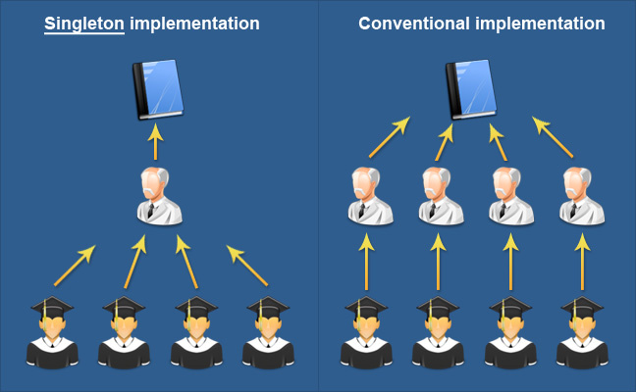
DESIGN PATTERN
<number>

Slide 18
DESIGN PATTERN
Factory
Sub-classes are responsible to create the instance of the class.
<number>

Slide 19
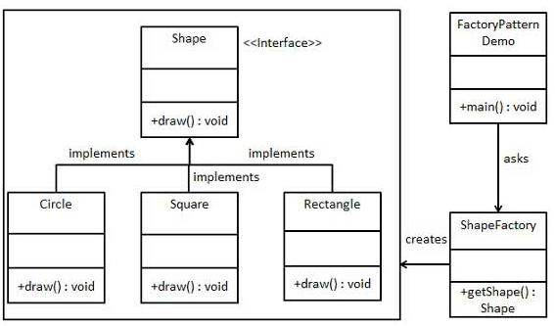
DESIGN PATTERN
<number>

Slide 20





OOD PRINCIPLE
Single
Liskov
Dependency
Responsibility
Substitution
Inversion
Open/close
Interface
Principle
Segregation
<number>

Slide 21
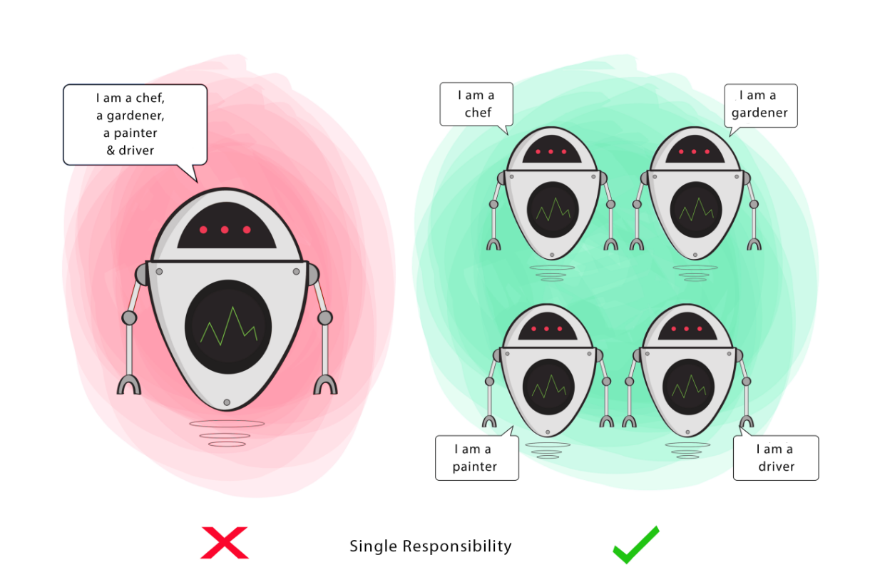
OOD PRINCIPLE
<number>

Slide 22
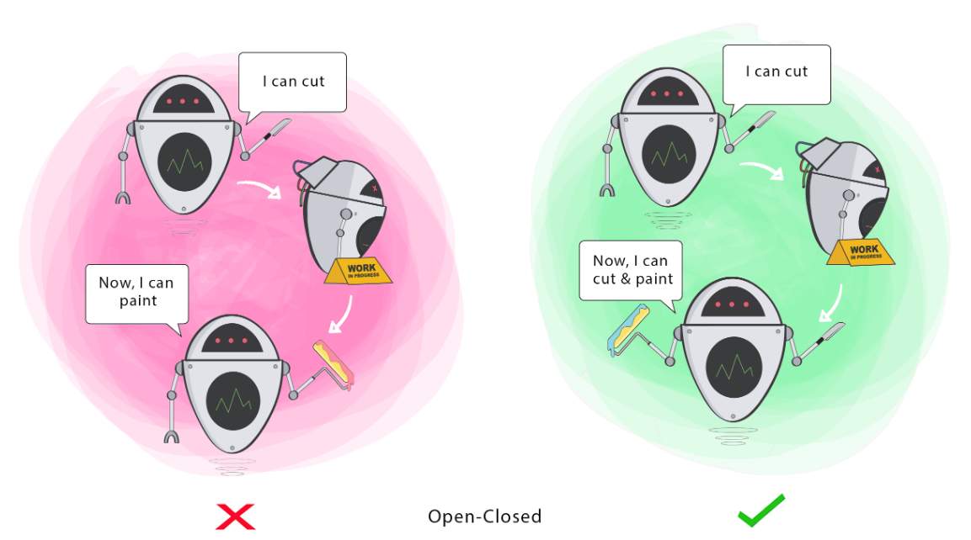
OOD PRINCIPLE
<number>

Slide 23
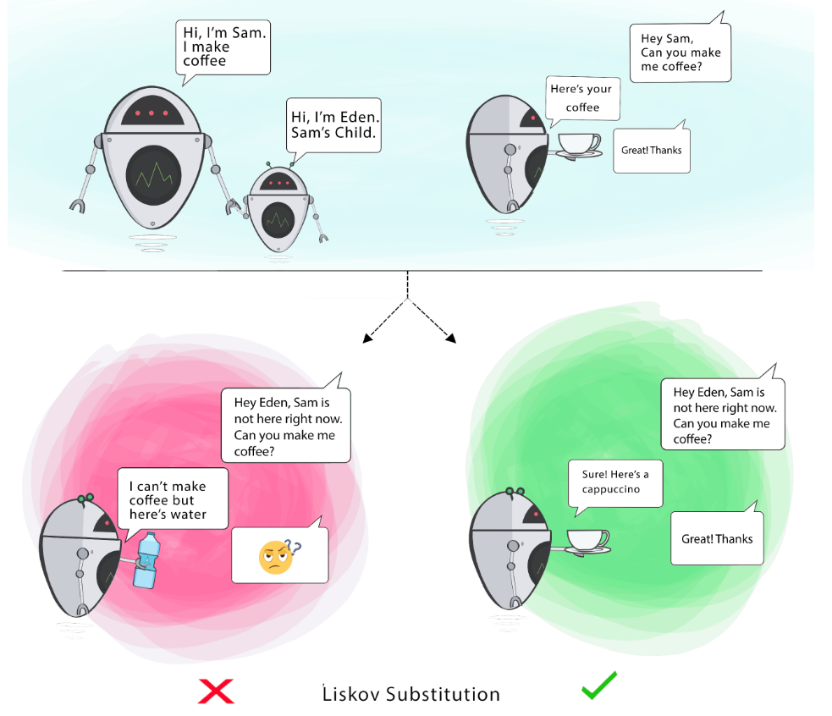
OOD PRINCIPLE
<number>

Slide 24
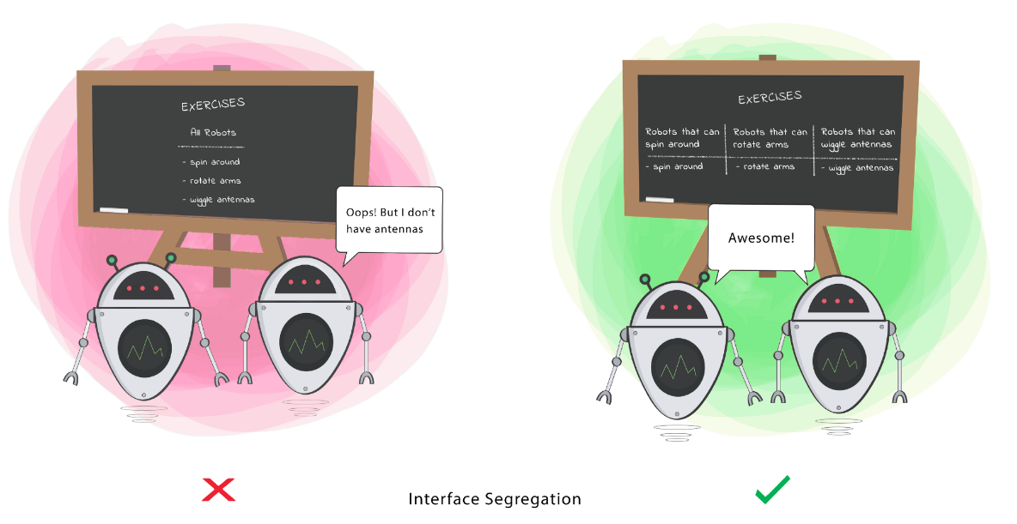
OOD PRINCIPLE
<number>

Slide 25
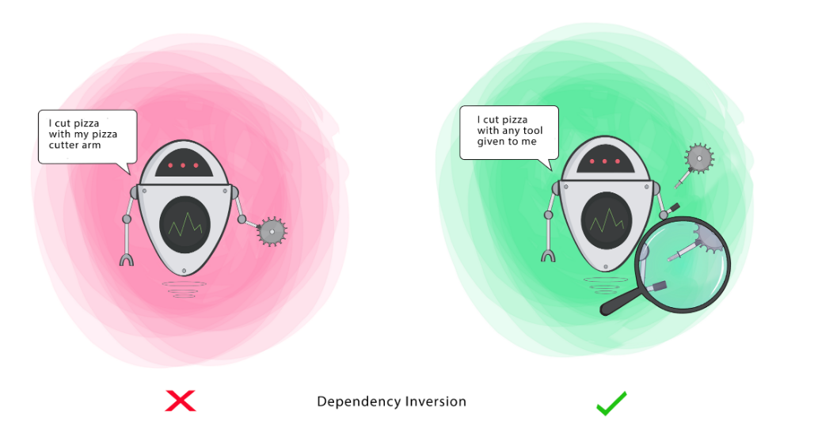
OOD PRINCIPLE
<number>

Slide 26
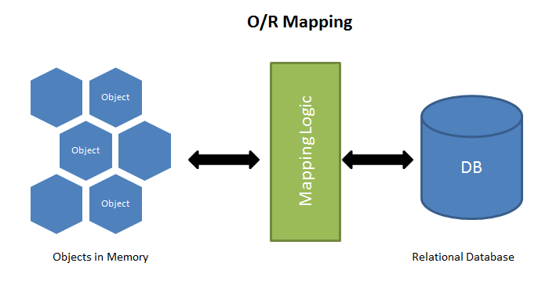
ORM
<number>

Slide 27

HIBERNATE
<number>

Slide 28
HIBERNATE
JAVA APPLICATION
Persistent Object
Hibernate
Session Factory
Session
Second-level cache
Transaction
Configuration
Query
First-level cache
Database
<number>

Slide 29
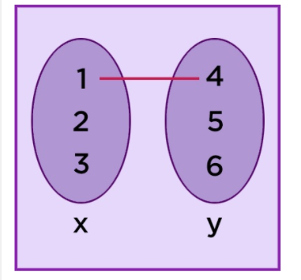
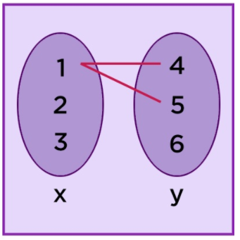
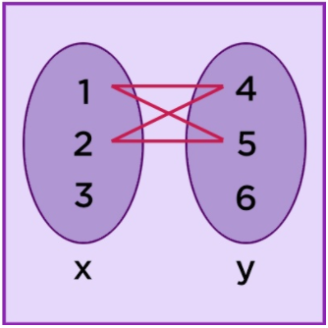
HIBERNATE
One To Many
Many To Many
One To One
<number>

Slide 30
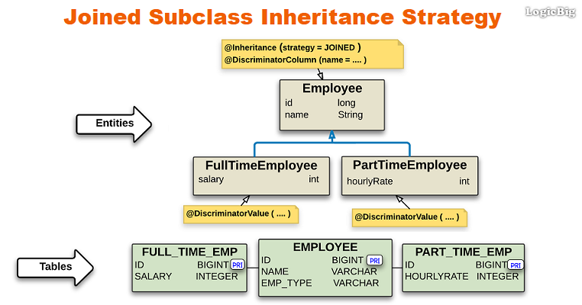
HIBERNATE
<number>

Slide 31

SPRING
<number>

Slide 32
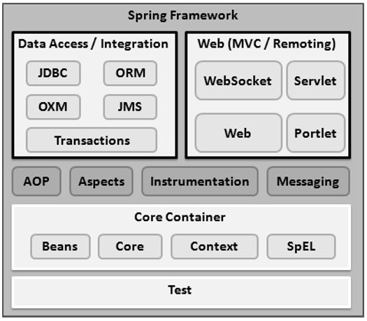
SPRING
<number>

Slide 33
SPRING
DI
Dependency Injection
Constructor-based
Setter-based
<number>

Slide 34
Aspect
Proxy
Join point
AOP
Weaving
Advice
Target Object
Pointcut
<number>

Slide 35
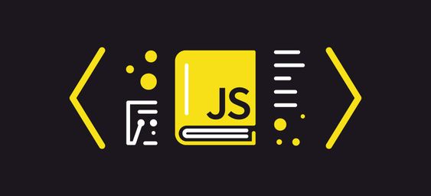
JAVASCRIPT
<number>

Slide 36
JAVASCRIPT
Syntax
JavaScript syntax is the set of rules
Events
The change in the state of an object is known as an Event.
Functions
Function is block of code designed to perform a particular task. Executed when “Something” calls it.
Cookies
Are data, stored in small text files, on your computer.
<number>

Slide 37
JAVASCRIPT
Objects
Are variables too. But objects can contain many values
HTML DOM
Allows JavaScript to change the content of HTML elements.
RegExp
Is a sequence of characters that forms a search pattern.
Debugging
Set any breakpoints, and examine variables while the code is executing.
<number>

Slide 38
JAVASCRIPT
Error handling
JavaScript catches adddlert as an error , and executed the catch code to handle it.
Validations
Provides a way to validate form’s data on the client before sending it to the server.
<number>

Slide 39
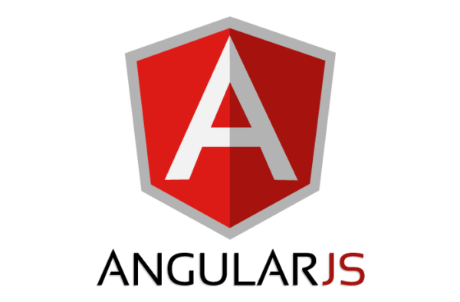
ANGULARJS
<number>

Slide 40
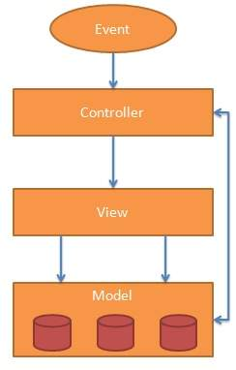
ANGULARJS
<number>

Slide 41
ANGULARJS
Controller
Modules
Dependency injection
Data binding
Expression
Scope
Service
Provider
Factory
Directive
<number>

Slide 42
ANGULARJS
Module
A container for the different parts of application
Controller
Control data of AngularJS application and controller are regular JavaScript Object
Directive
AngularJS lets you extend HTML with new attributes
Data binding
The synchronization between the model and view
<number>

Slide 43
ANGULARJS
Dependency injection
Is a software design model in which the components are derived from its dependencies
Scope
Is the binding part between the HTML (view) and the JavaScript (controller)
Service
A service is a function, or object, that is available for, and limited to, your AngularJS application.
Expression
Is used to bind data via HTML, it can be written inside double braces and written inside a directive
<number>

Slide 44
ANGULARJS
Factory
Is a function to use to return values. It generates the required value each time the service or controller requests it.
Provider
Used by AngularJS internally to create service, factory ... during the installation process
<number>

Slide 45
ANGULARJS
AngularJS Material provides a set of reusable, well-tested, and accessible UI components for AngularJS developers.
AngularJS Material
<number>

Slide 46
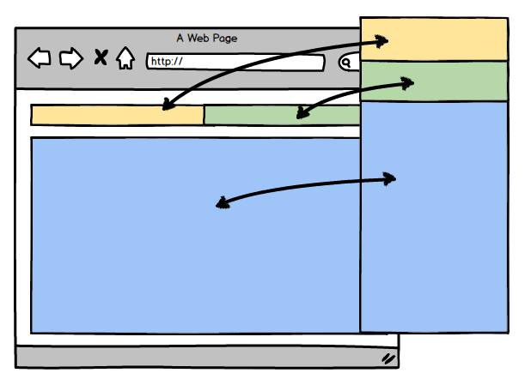
ANGULARJS
<number>

Slide 47
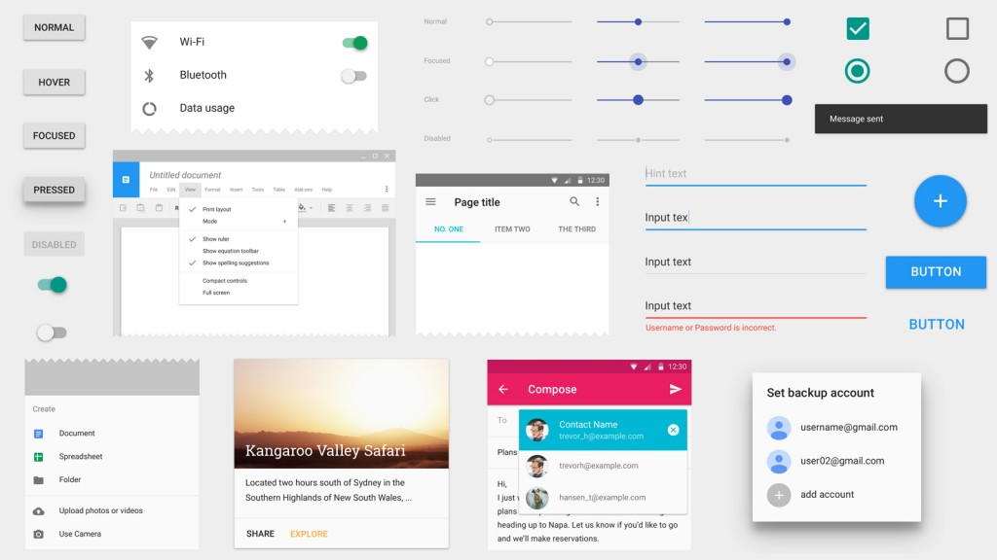
ANGULARJS
<number>

Slide 48
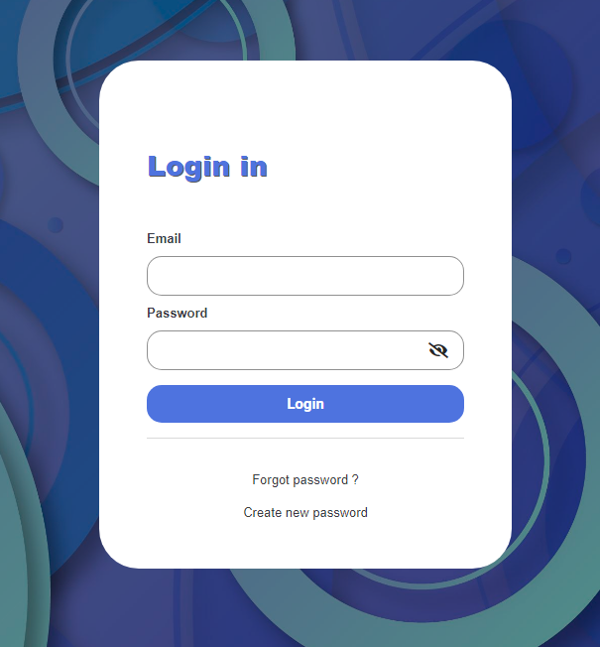
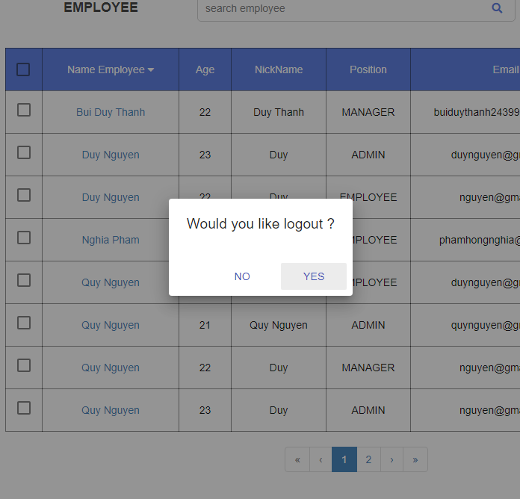
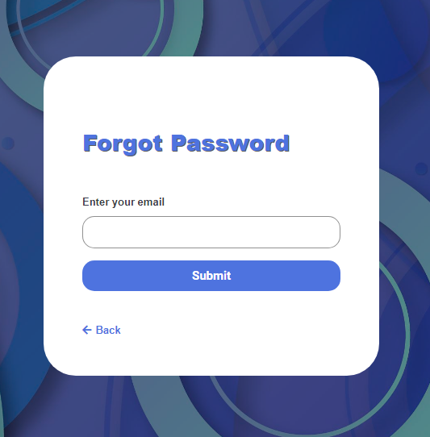
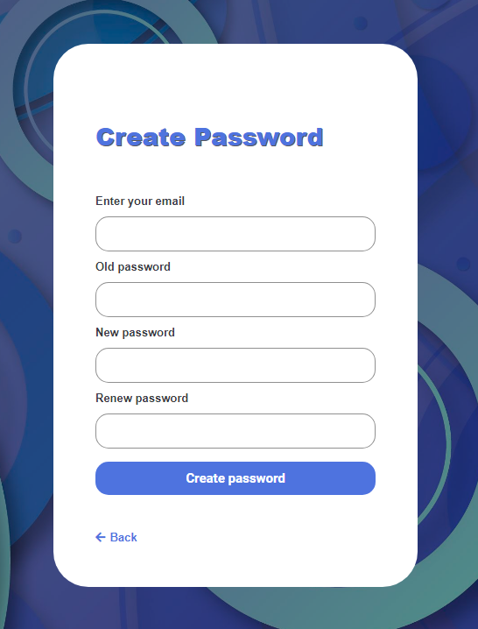
Demo Project
<number>

Slide 49
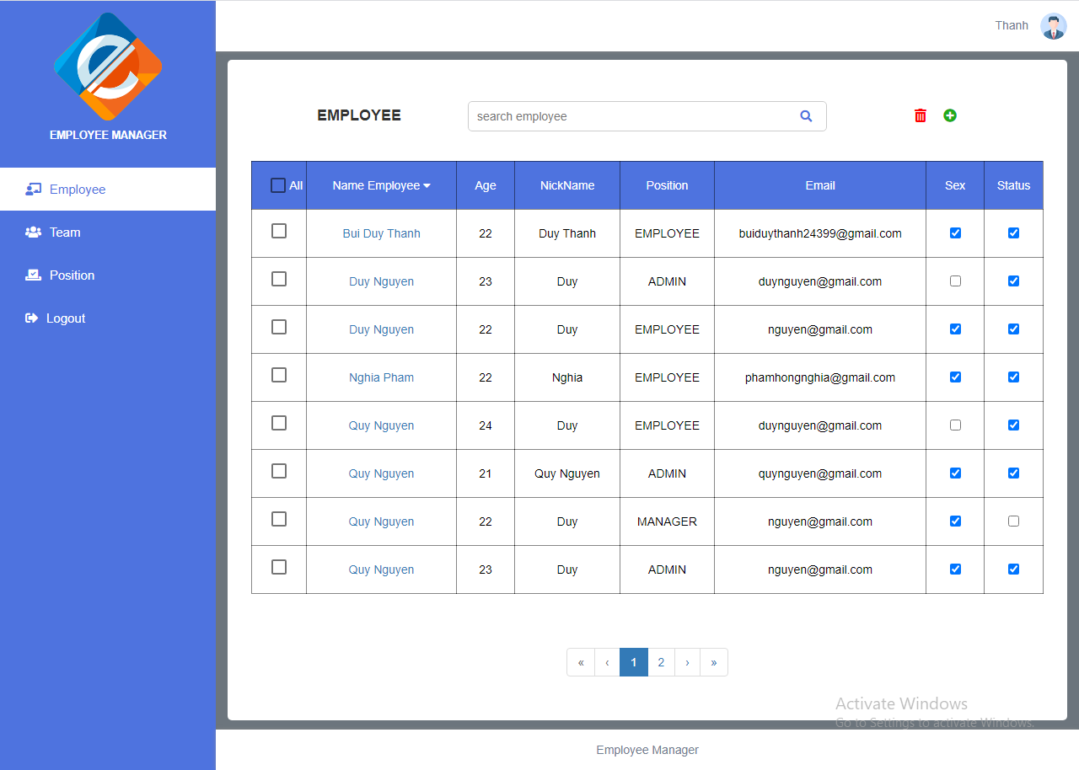
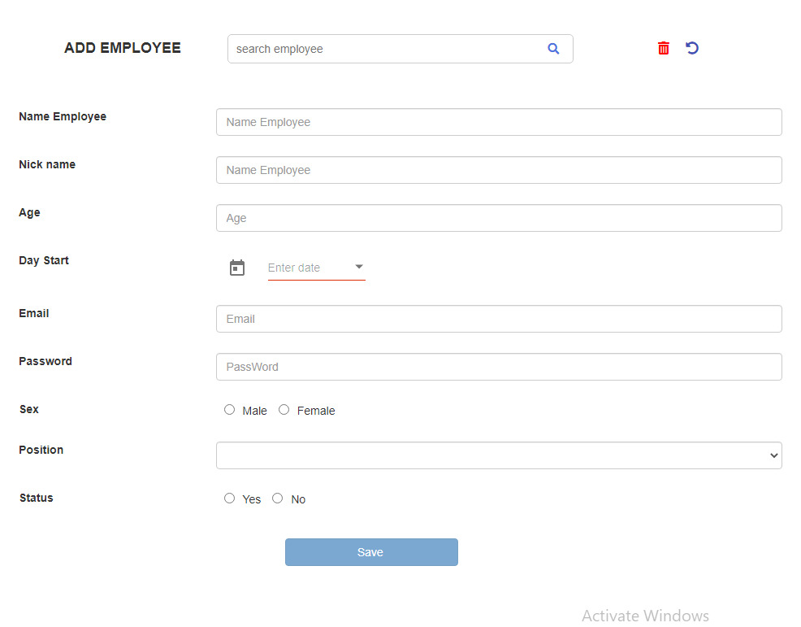
Demo Project
<number>

Slide 50
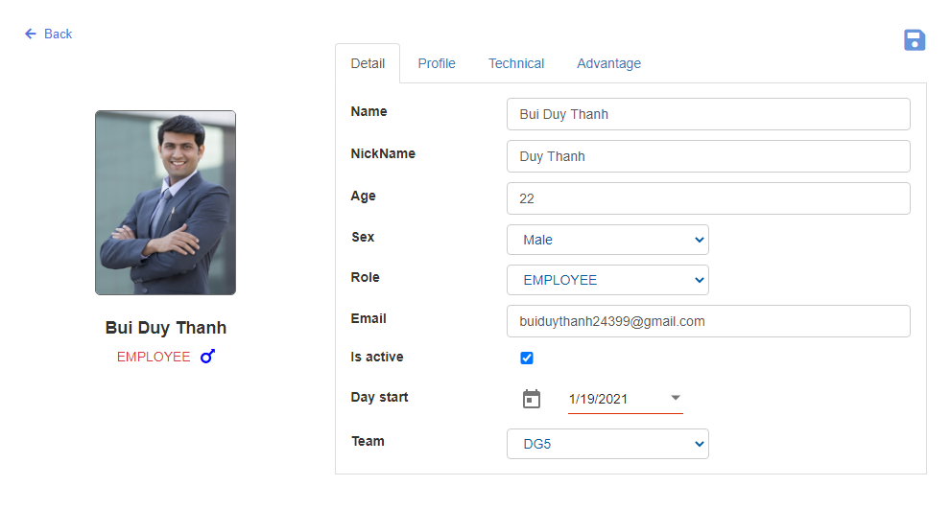
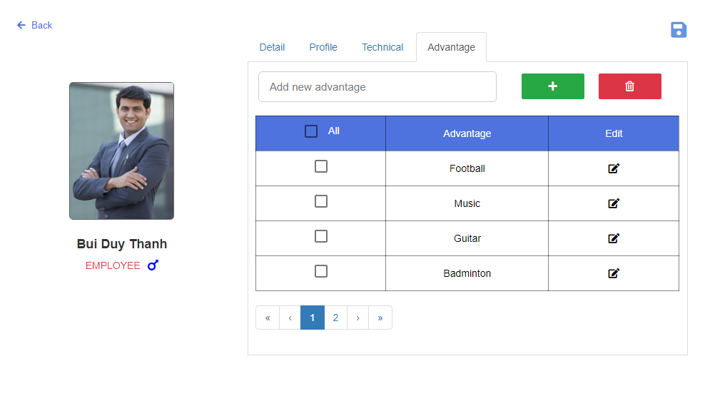
Demo Project
<number>

Slide 51
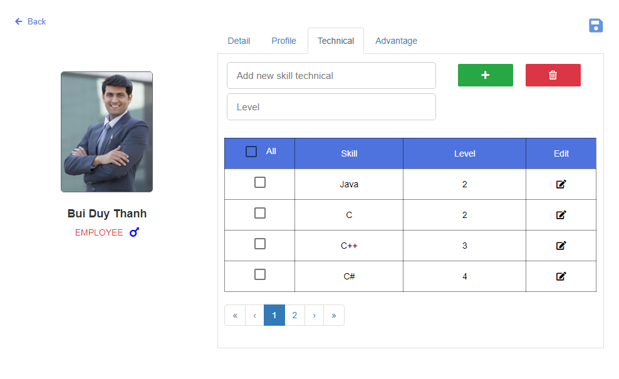
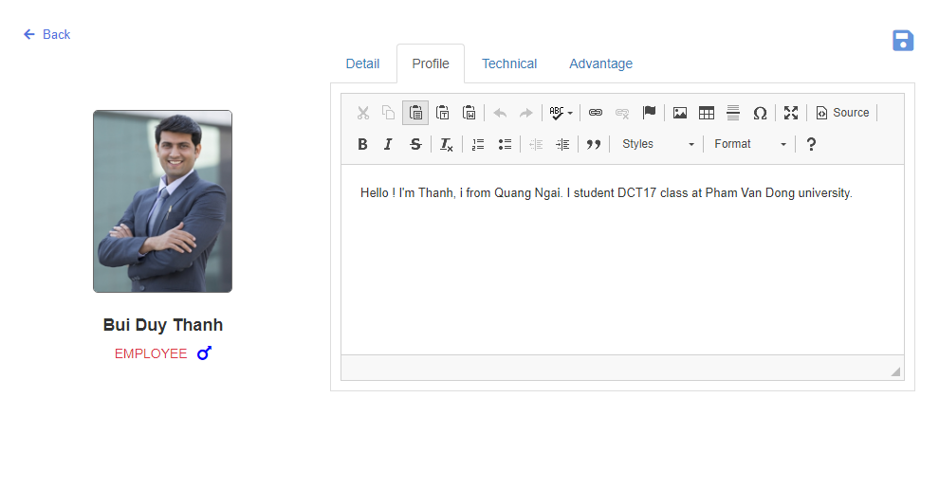
Demo Project
<number>

Slide 52
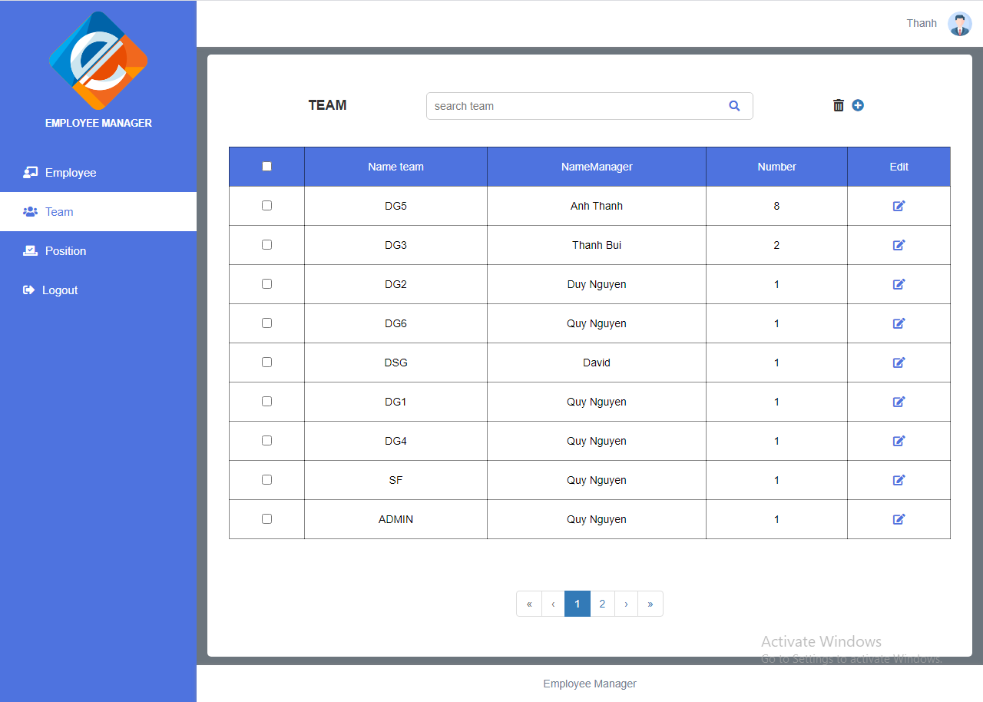
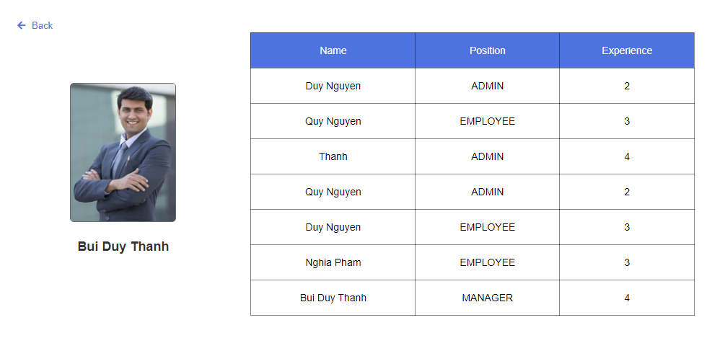
Demo Project
<number>

Slide 53
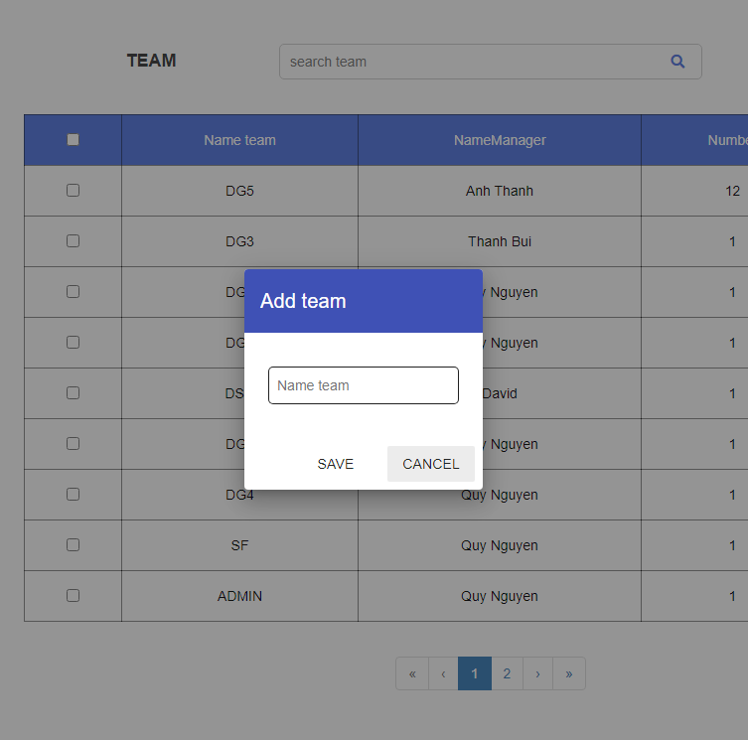
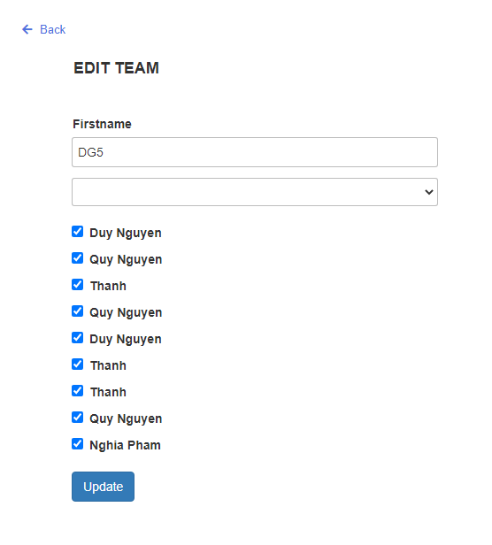
Demo Project
<number>

Slide 54
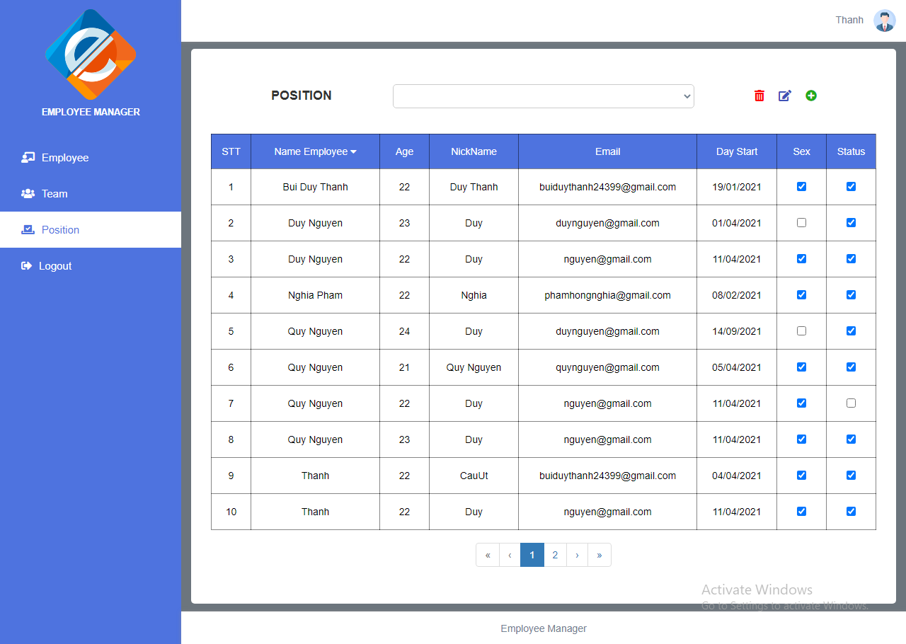
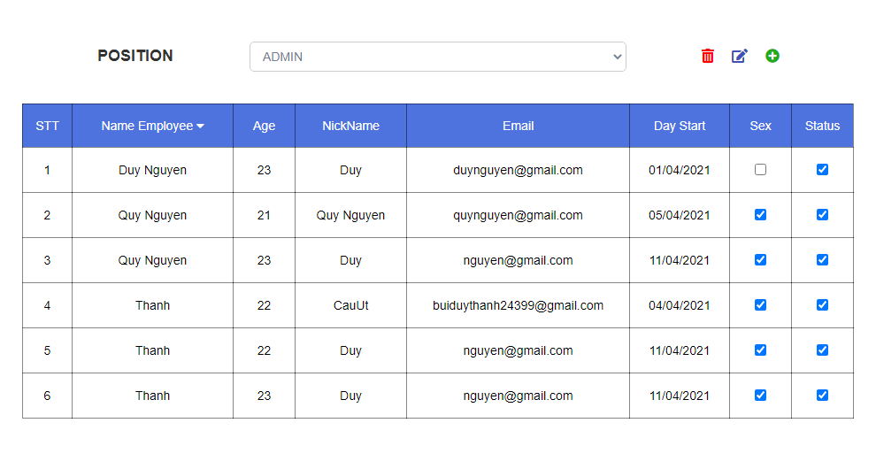
Demo Project
<number>

Slide 55
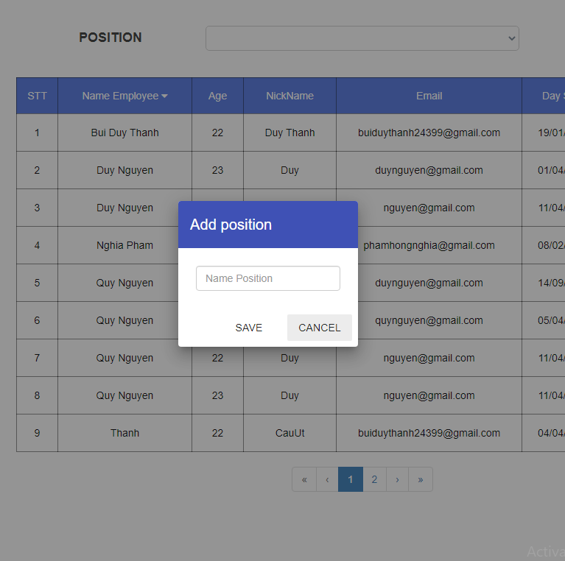
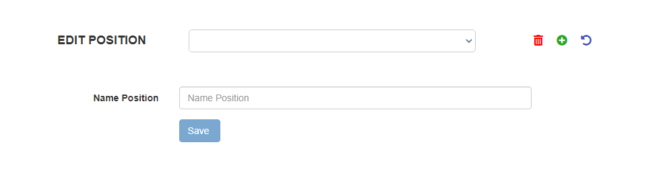
Demo Project
<number>

Slide 56

<number>

